Slide 1
Presentation for assignment 1
Author: Vu Dinh Cong-BH01779

Slide 2
About business process support
Business process support is essential for the success of the organization. It involves systems and practices that streamline operations, improve efficiency, and enhance decision-making.

Slide 3

Understanding business data
Business data refers to the raw facts and figures that organizations collect. It plays a crucial role in supporting business processes by providing the information needed for analysis and decision-making.

Slide 4

The role of information in business
Information is data that is processed with meaning and context. Unlike raw data, information is valuable for making informed decisions and guiding business strategies.

Slide 5
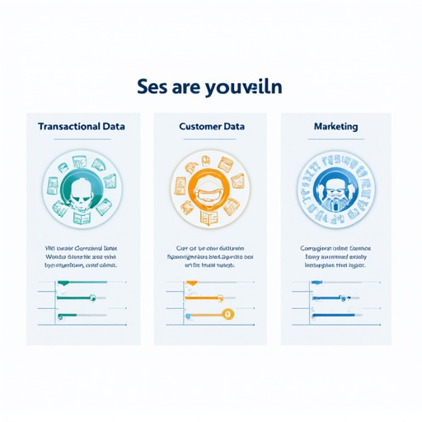
Types of data used in business
Businesses use many different types of data, including:
Dữ liệu giao dịch: Hồ sơ giao dịch, chẳng hạn như mua bán.
Dữ liệu khách hàng: Thông tin về khách hàng, bao gồm nhân khẩu học và sở thích.
Dữ liệu tiếp thị: Dữ liệu liên quan đến các chiến dịch tiếp thị và hiệu quả của chúng.

Slide 6

The value of data and information in business processes
Data and information support business processes by:
Improve decision-making.
Improve operational efficiency.
Provide insights that drive value for the organization.

Slide 7

Data-driven decision-making
Data-driven decision-making involves the use of data to guide business choices. This approach helps organizations make informed decisions that positively impact overall performance.

Slide 8

Improve customer satisfaction through data
Data can significantly improve customer satisfaction by:
Analyze customer feedback and preferences.
Personalize services and products based on customer data.
Implement targeted marketing strategies.

Slide 9

Increase revenue and profits through data
Effective use of data can lead to increased revenue and profitability by:
Identify new market opportunities.
Optimize pricing strategies based on data analysis.
Improve the accuracy of sales forecasting.

Slide 10

Solving problems with data
Data helps identify and solve business problems by:
Analyze trends and patterns to spot problems.
Providing insights provides insights for corrective actions.
Support root cause analysis to solve problems effectively.

Slide 11

Improve your company's processes with data
Data can enhance and streamline a company's processes by:
Identify inefficiencies and bottlenecks.
Supports automation and process optimization.
Facilitate continuous improvement initiatives.

Slide 12
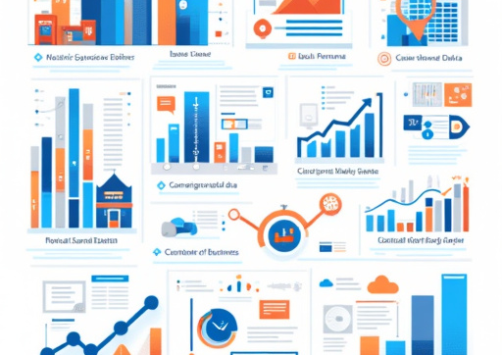
Create data in your business
Data is generated in a variety of ways in a business context, including:
Transactional data: Collected during sales and operations.
Customer data: Collected through interactions and surveys.
Marketing data: Generated from campaigns and customer engagement.

Slide 13

Types of data generated
The different types of data generated in a business include:
Transaction data: Sales records, invoices, and purchase orders.
Customer data: Profiles, interests, and purchase history.
Marketing data: Campaign performance metrics and engagement statistics.

Slide 14

Social and web analytics data
Social media and web analytics play a critical role in generating valuable business data by:
Tracking online user engagement and behavior.
Analyze social media interactions to gauge brand sentiment.
Provide insights for targeted marketing efforts.

Slide 15

Use data to make decisions
Businesses use data to make decisions and plan strategies by:
Analyzing historical data to forecast future trends.
Use data analytics tools to gain actionable insights.
Supporting evidence-based decision-making processes.

Slide 16

Marketing and engaging with customers through data
Leveraging data for marketing and customer acquisition includes:
Customer segmentation based on data analysis.
Personalize marketing messages to increase engagement.
Measure campaign performance through data metrics.

Slide 17

Manage risk with data
Data is important in risk management by:
Identifying potential risks through data analysis.
Supporting proactive decision-making to mitigate risk.
Monitor risk factors continuously to ensure the resilience of the business.

Slide 18

Monitor and improve performance with data
Data is used to track business performance and drive improvement by:
Setting data-driven key performance indicators (KPIs).
Analyze performance indicators to identify areas for improvement.
Implement data-driven strategies for continuous improvement.

Slide 19

Overview of data processing tools
Various tools are used to process data, including:
Microsoft Excel: For manipulating and analyzing data.
SQL: For managing and querying business data.
Power BI: To visualize data and support business insights.

Slide 20
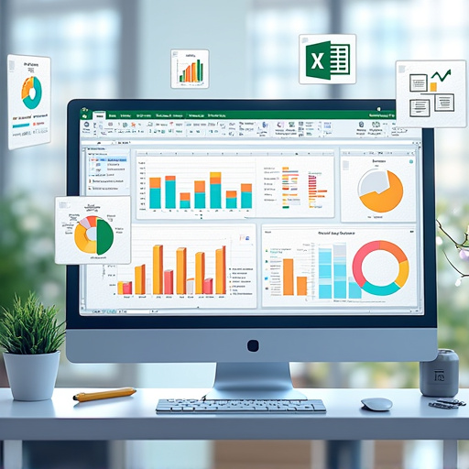
Microsoft Excel for data processing
Microsoft Excel is a powerful tool for manipulating and analyzing data. It allows users to:
Organize and analyze data using formulas and functions.
Create charts and graphs to visualize data.
Perform complex calculations and model data.

Slide 21

SQL for data management
SQL (Structured Query Language) is used to manage and query business data. It allows users to:
Retrieve specific data from the database.
Update and manipulate data efficiently.
Generate reports and insights based on data queries.

Slide 22

Power BI for data visualization
Power BI plays a critical role in visualizing data and supporting business insights by:
Transforming raw data into interactive dashboards.
Allow users to explore data visually for better understanding.
Facilitate data sharing and collaboration across teams.

Slide 23
Power BI Analysis
Business Processes
Production Planning: Data helps determine which products are selling well (e.g., Road-650 Black, 58 units at 52,003.13) to increase production, and which products are not popular (e.g., Mountain-200 Black, 42 ​​at 1,164.53) to adjust.
Marketing Strategy: Focus on promoting high-volume products (e.g., Road-650 Black, 8.13% and Mountain-100 Black, 7.95%) instead of low-volume products.
Inventory Management: Reduce inventory for slow-moving products (e.g., Mountain-200 Black) and optimize for key products.

Slide 24
Power BI Analysis
Benefits
Data-driven decision making: Businesses can allocate resources more efficiently based on actual sales (e.g., 29k units of Road-650 Black account for 47.93% of total sales).
Increase sales: Focusing on best-selling products (like Road-650 Black) can maximize profits.
Competitiveness: Understanding color trends (Black is dominant) helps businesses respond to market demands quickly.

Slide 25
Power BI Analysis
Challenges
Risk of data bias: If data focuses only on the color Black, businesses may overlook customer demand for other colors (e.g., red, blue), resulting in lost market opportunities.
Cost management: Producing too much of a hot-selling product (like Road-650 Black) without balancing it can lead to waste if demand drops.
Relying on incomplete data: If charts do not reflect data by region, season, or time, decisions may be inaccurate.

Slide 26
Power BI Analysis
Positive Impact
Operational Efficiency: Data shows that Road-650 Black and Mountain-100 Black are the two flagship products (together accounting for ~16% of total revenue), helping the business prioritize production and distribution.
Resource Optimization: With total revenue of 24,717,186.42, the business can calculate profit margins and invest in high-value products (like Mountain-500 Black, 44 with 27,794.91).
Market Feedback: The dominance of Black (which occupies the majority of the chart) reflects customer preferences, allowing for appropriate design or sales strategy adjustments.

Slide 27
Power BI Analysis
Negative Impacts
Lack of Diversity: The focus on Black may reduce the brand’s appeal if customers want to diversify their color choices.
Security Risks: If this data is leaked (e.g. via an unencrypted chart), competitors could exploit it to adjust their strategies, causing damage.
Limited Analysis: The chart does not provide detailed information on unit selling price or trends over time, leading to potential decision bias.

Slide 28
Conclusion
Data from charts provides great value in optimizing business processes, especially in manufacturing and marketing, with clear benefits such as increased efficiency and competitiveness.
However, challenges such as data bias, security risks, and lack of detailed information require businesses to incorporate other data sources (such as customer data, market trends) to make comprehensive decisions.
To improve, businesses should analyze additional factors such as selling price, sales region, and seasonality, and protect data to avoid risks.

Slide 29
Tools used in the project
In this project, the following tools were used:
Microsoft Excel: For data analysis and visualization.
SQL: For managing and querying datasets.
Power BI: To create visual reports and dashboards.

Slide 30

Kết thúc
Tóm lại, dữ liệu rất quan trọng trong việc hỗ trợ các quy trình kinh doanh. Nó nâng cao khả năng ra quyết định, cải thiện sự hài lòng của khách hàng, tăng doanh thu và giúp giải quyết vấn đề. Hiểu và tận dụng dữ liệu một cách hiệu quả là điều cần thiết cho sự thành công của tổ chức.

